Slide 1


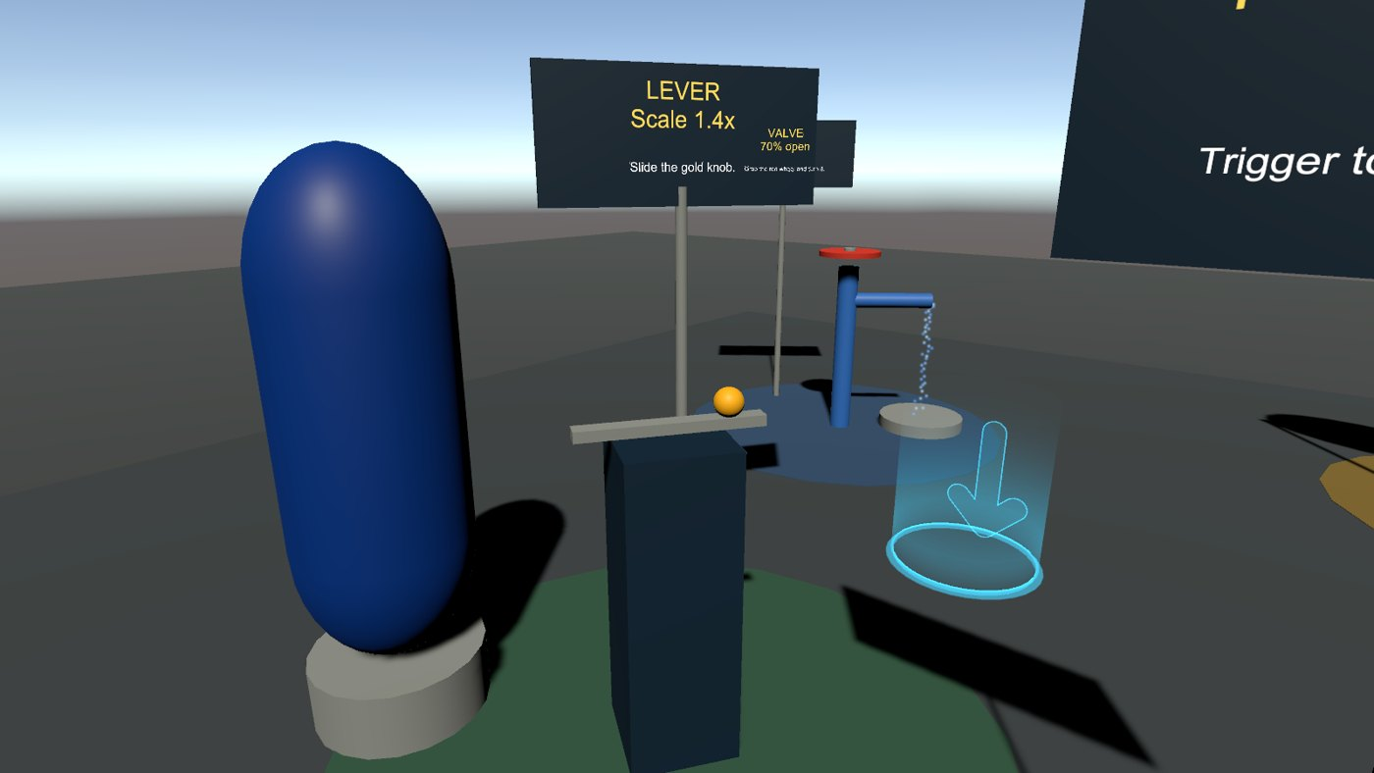

Virtual Reality
Interactive VR: interactivity without code, then with C#
Wednesdays at 6:00pm
CIST 1423 - 2010 VIRTUAL REALITY PROGRAMMING AND TECHNOLOGY
Homework: one no-code + one C# interaction, documented with UML or pseudocode

Slide 2



Agenda
No-code interactivity
Interactivity with C#
Document it
Imported assets, teleport anchors, Animator
A UI slider that scales an object
UML or pseudocode for your two interactions

Slide 3

Today
By the end of class you can…
Add interactivity without code: imported assets, teleport anchors, Animator loops
Tonight's plan
1
0–10
Review
Script an interaction in C#: a slider that scales an object
2
10–40
No-code vs C# interactivity
40–50
Lab briefing
Document interactions with a UML diagram or pseudocode
3
50–130
Lab: one no-code + one C# interaction
130–145
Share-out
145–150
Exit ticket
CIST 1423 — Week 9 — Building Interactive VR Experiences (Ch. 5)

Slide 4



Interactivity without code
The textbook does this with XRI components; here are the SteamVR equivalents.
Import an asset
Teleport anchors
Animator-driven motion
Asset Store / .fbx / .glb into Assets
Add a Collider + Interactable + Throwable
It's grabbable, with no script
XRI Teleportation Anchor = SteamVR TeleportPoint prefab
Drop it where you want people to stand
Lab 5 scene has two
Record a rotation/scale clip in the Animation window
Animator Controller loops it
No code: windmills, fans, spinning signs
GolfVR's windmill uses a script (ObstacleAnimator.Rotate) instead: both are fine; know when each is simpler.
CIST 1423 — Week 9 — Building Interactive VR Experiences (Ch. 5)

Slide 5

Animator: rotation and scaling in four steps
Window → Animation → Animation, with the object selected.
1. Create clip
2. Record
3. Loop
4. Trigger (optional)
Create → "Spin.anim". Unity adds an Animator + Controller to the object.
Red record button. Frame 0: rotation 0. Frame 60: rotation Y = 360.
Select the clip in Project → Loop Time ✓. Set tangents to linear for constant speed.
Add a second state and a Trigger parameter; a HoverButton's onButtonDown calls animator.SetTrigger("Grow").
Scaling tip
Animate a parent, not the mesh with the collider, so physics and pivots stay predictable.
CIST 1423 — Week 9 — Building Interactive VR Experiences (Ch. 5)

Slide 6


C#: scale an object with a UI slider
The Ch. 5 exercise, in SteamVR terms: a world-space Canvas with a Slider, driven by the UIElement / laser input.
using UnityEngine;
using UnityEngine.UI;
public class SliderScaler : MonoBehaviour
{
public Slider slider; // world-space Canvas, 1-2 m from the player
public Transform target; // the thing to resize
public float minScale = 0.1f, maxScale = 2f;
void Awake() => slider.onValueChanged.AddListener(Apply);
void Apply(float t) // slider value 0..1
{
float s = Mathf.Lerp(minScale, maxScale, t);
target.localScale = Vector3.one * s;
}
}
We already built this, on the web
panther-builder's scale slider: 0.05× to 1.5×
landing.js oninput → panther.setScale(v)
VR UI rules
World-space Canvas, 1–2 m away
Big targets, high contrast
Never lock UI to the head
CIST 1423 — Week 9 — Building Interactive VR Experiences (Ch. 5)

Slide 7
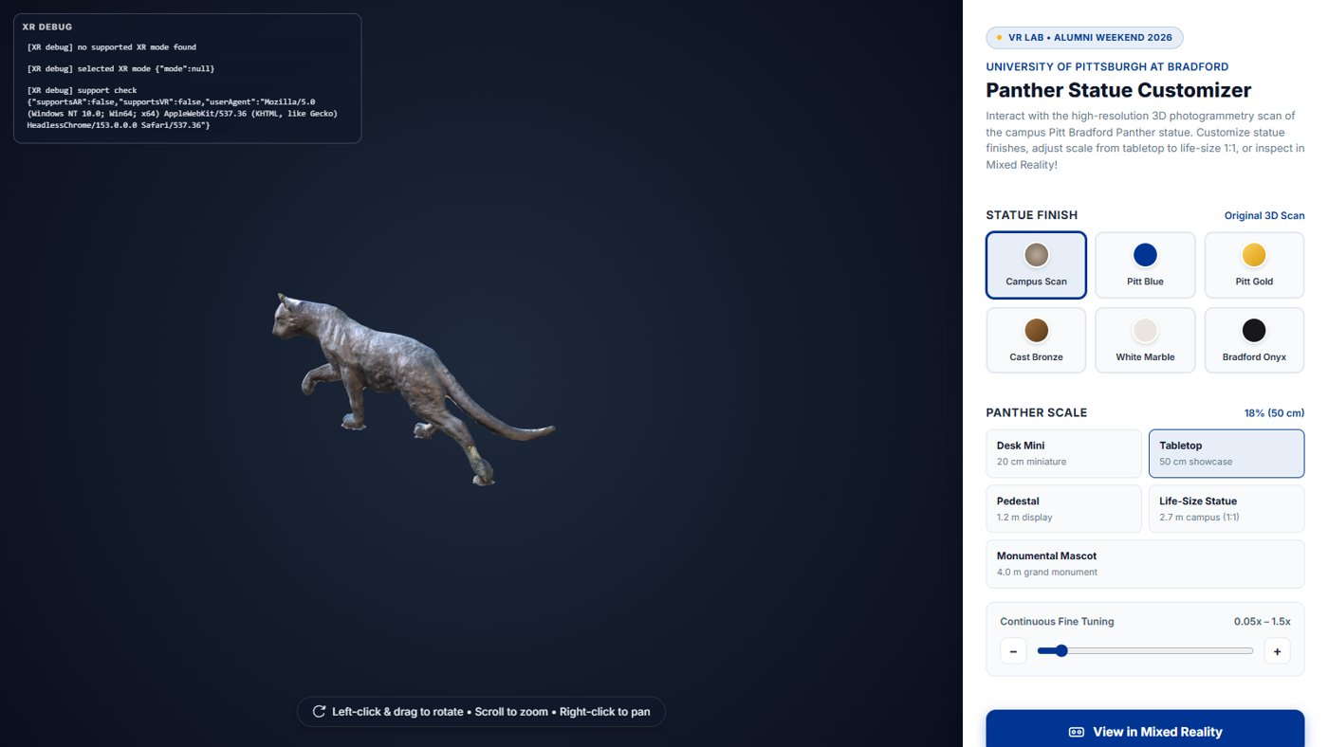


The same interaction in our web app
Event → state → view
Input event (slider) changes state (scale)
The scene reflects state
Same pattern in Unity and the web
Homework diagram
Draw it: Slider → SliderScaler.Apply → Transform
UML sequence diagram or 5 lines of pseudocode
panther-builder: preset buttons + a continuous scale slider, mirrored into the 3D scene every frame.
CIST 1423 — Week 9 — Building Interactive VR Experiences (Ch. 5)

Slide 8
Check your understanding
Answer with a partner first, then we'll compare.
Q1
Q2
Q3
Which SteamVR prefab plays the role of an XRI Teleportation Anchor?
In the Week 5 Playground, what component turns the lever into a 0–1 value?
Why animate a parent instead of the mesh with the collider?
CIST 1423 — Week 9 — Building Interactive VR Experiences (Ch. 5)
Notes:
Answers:
Q1. Which SteamVR prefab plays the role of an XRI Teleportation Anchor?
TeleportPoint.
Q2. In the Week 5 Playground, what component turns the lever into a 0–1 value?
LinearMapping, written by LinearDrive.
Q3. Why animate a parent instead of the mesh with the collider?
Physics and pivots stay predictable.

Slide 9

Next steps: homework + planning
Add one no-code interaction (teleport anchor or Animator loop) to your prototype
Add one C#-scripted interaction (slider scaler, button, or your own)
Document both with a UML diagram or pseudocode in Markdown
Next week: Ch. 6, interactive AR menus
CIST 1423 — Week 9 — Building Interactive VR Experiences (Ch. 5)

